Slide 1



Gaussian Processes & Regressors
A visual introduction to Gaussian Processes
Mads-Peter V. Christiansen
Slides here: nanospace2025.mads-peter.com

Slide 2
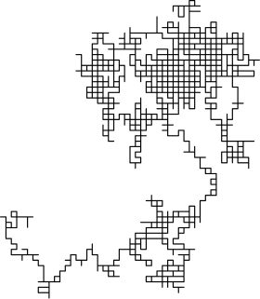
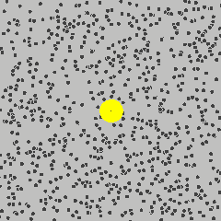
Stochastic Process:
"A collection of random variables indexed by time, space, or some other domain.”
Think a recipe for generating sequences of random variables.
Random walk
Brownian Motion

Slide 3
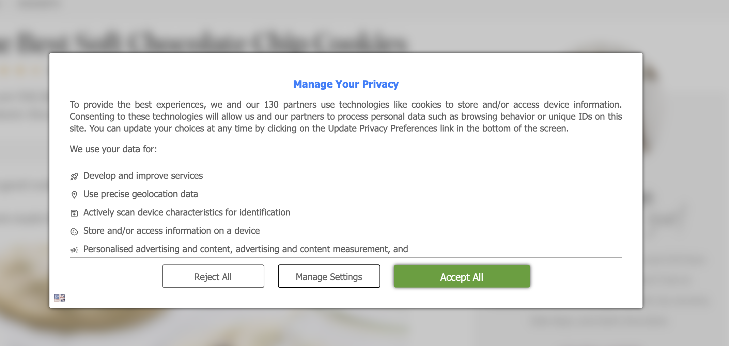



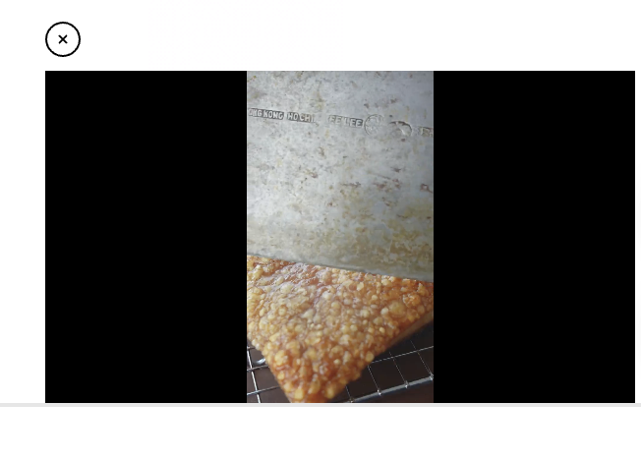

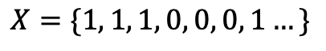
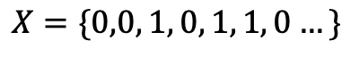
Bernoulli Process:
Sequence of random variables each drawn iid. from a Bernoulli distribution.
This definition tells us what the recipe is.
Bernoulli Distribution
Bernoulli Process
Sample paths drawn from the process
0
1
$$X=\{0,0, 1, 0, 1, 1, 0…\}$$
$$≠$$
$$X=\{1, 1, 1, 0, 0, 0, 1…\}$$
Tells you how to draw a collection of random variables
Tells you how to draw a single random variable

Slide 4
Bernoulli Process:
Sequence of random variables each drawn iid. from a Bernoulli distribution.
This definition tells us what the recipe is.
Bernoulli Distribution
Bernoulli Process
Sample paths drawn from the process
0
1
$$X=\{0,0, 1, 0, 1, 1, 0…\}$$
$$≠$$
$$X=\{1, 1, 1, 0, 0, 0, 1…\}$$
Tells you how to draw a collection of random variables
Tells you how to draw a single random variable

Slide 5
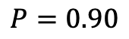
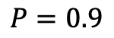
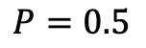
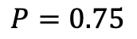
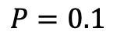
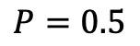
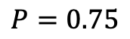
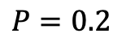
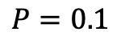
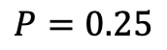
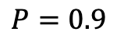
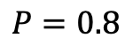
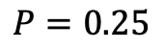
Mads-Peter Process
Sequence of states drawn from Mads-Peter’s decision process while travelling to Finland for the Nanospace Training School.
Alarm rings
$$P=0.1$$
$$P=0.9$$
$$P=0.75$$
Train on time
$$P=0.90$$
Arrive at train station
on time
Snooze 10 mins
$$P=0.5$$
$$P=0.9$$
Arrive at airport
on time
Get ready
$$P=0.25$$
$$P=0.1$$
Train delayed
$$P=0.25$$
$$P=0.5$$
$$P=0.75$$
Panic
$$P=0.8$$
$$P=0.2$$

Slide 6




Mads-Peter Process
Sequence of states drawn from Mads-Peter’s decision process while travelling to Finland for the Nanospace Training School.
Samples from my decision process
$$\{$$
$$\{$$
…
Alarm rings
Snooze 10 mins
Snooze 10 mins
Snooze 10 mins
Snooze 10 mins
Snooze 10 mins
$$\{$$
$$\{$$
Arrive at train station
on time
Arrive at airport
on time
Alarm rings
Snooze 10 mins
Train on time
Get ready

Slide 7
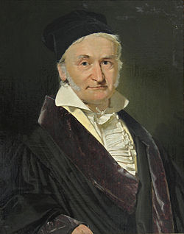
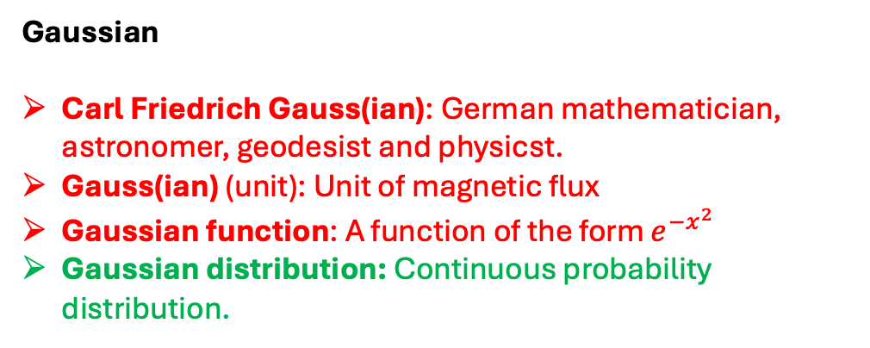
Gaussian
Carl Friedrich Gauss(ian): German mathematician, astronomer, geodesist and physicst.
Gauss(ian) (unit): Unit of magnetic flux
Gaussian function: A function of the form $e^{−x^{2}}$
Gaussian distribution: Continuous probability distribution.

Slide 8
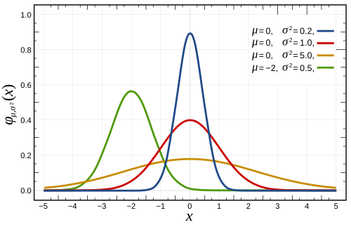
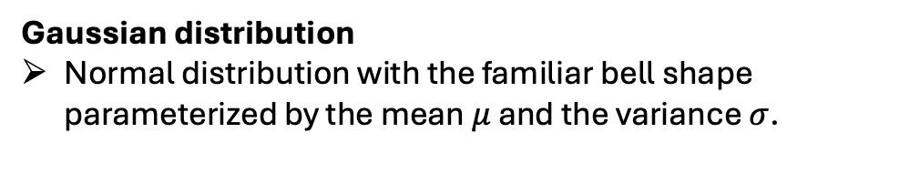
Gaussian distribution
Normal distribution with the familiar bell shape parameterized by the mean $μ$ and the variance $σ$.

Slide 9
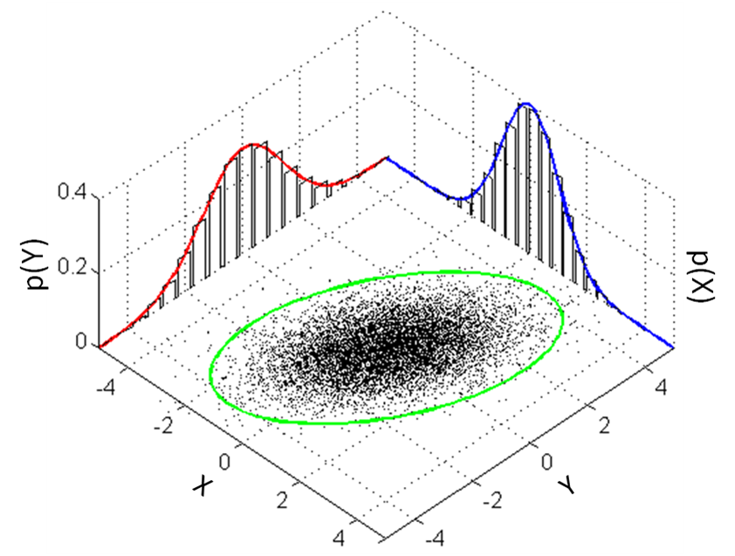
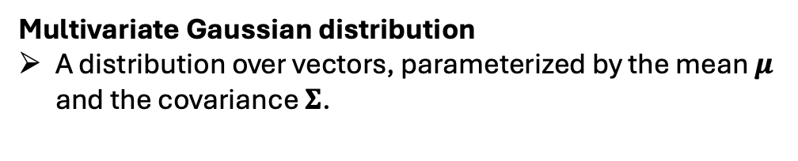
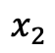
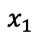
Multivariate Gaussian distribution
A distribution over vectors, parameterized by the mean $μ$ and the covariance $Σ$.
$$Σ$$
$$x_{1}$$
$$x_{2}$$

Slide 10
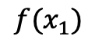
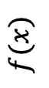
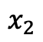
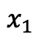
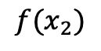
$$Σ$$
$$f(x)$$
$$x_{1}$$
$$x_{2}$$
$${f(x}_{1})$$
$${f(x}_{2})$$

Slide 11
$$Σ$$
$$f(x)$$
$$x_{1}$$
$$x_{2}$$
$${f(x}_{1})$$
$${f(x}_{2})$$

Slide 12
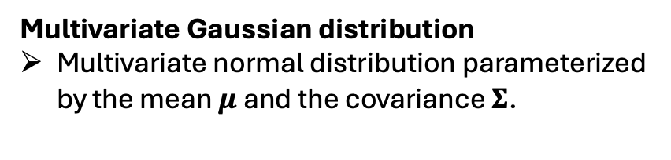
Multivariate Gaussian distribution
Multivariate normal distribution parameterized by the mean $μ$ and the covariance $Σ$.
Stochastic Process:
"A collection of random variables indexed by time, space, or some other domain.”
Gaussian Process
A stochastic process where samples are generated by drawing from a multivariate Gaussian distribution indexed by time, space or some other domain.

Slide 13
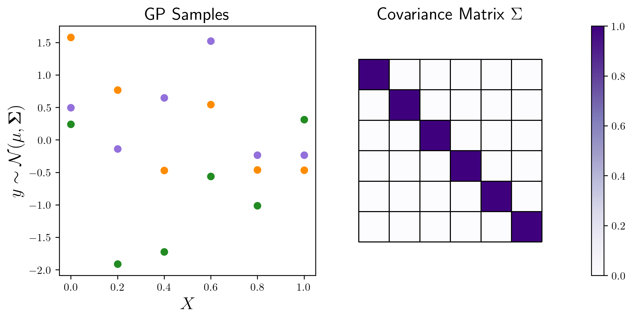
Gaussian Process
“A stochastic process where samples are generated by drawing from a multivariate Gaussian distribution indexed by time, space or some other domain.”
Three samples from the GP.
“… indexed by time, space or some other domain.”

Slide 14
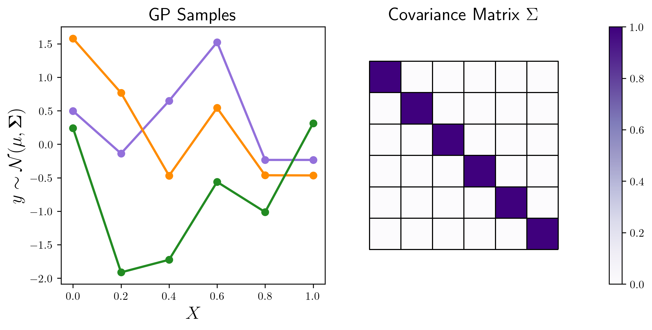
Gaussian Process
“A stochastic process where samples are generated by drawing from a multivariate Gaussian distribution indexed by time, space or some other domain.”
Three samples from the GP.
“… indexed by time, space or some other domain.”

Slide 15
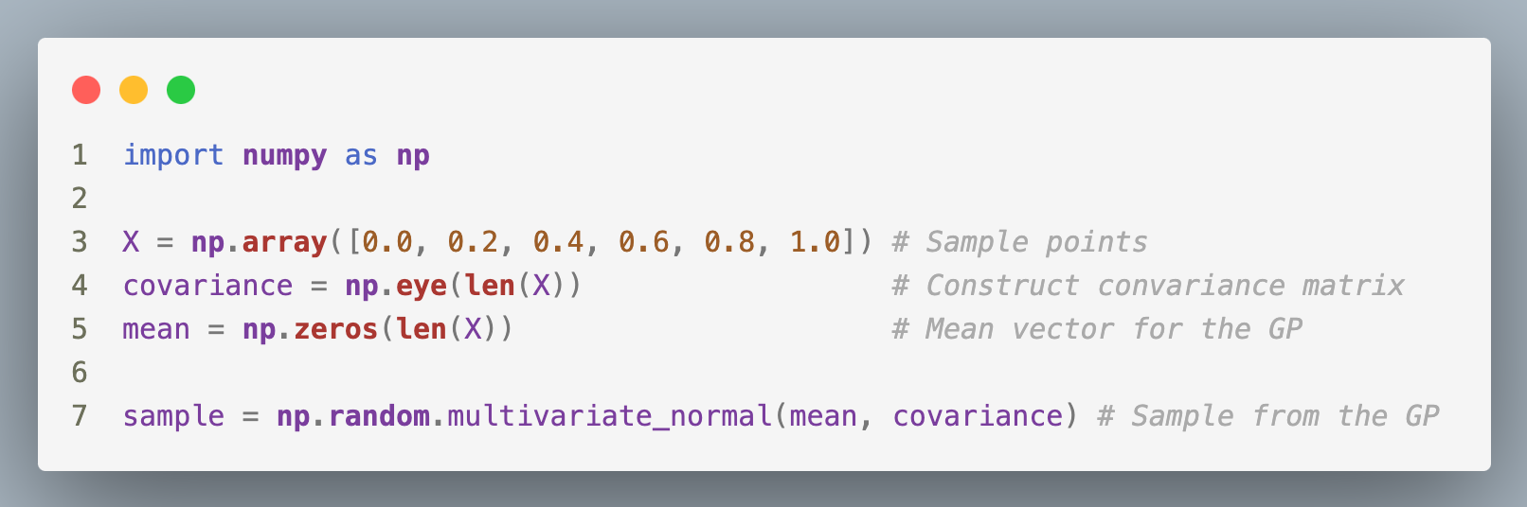
Gaussian Process
“A stochastic process where samples are generated by drawing from a multivariate Gaussian distribution indexed by time, space or some other domain.”
Three samples from the GP.
“… indexed by time, space or some other domain.”

Slide 16
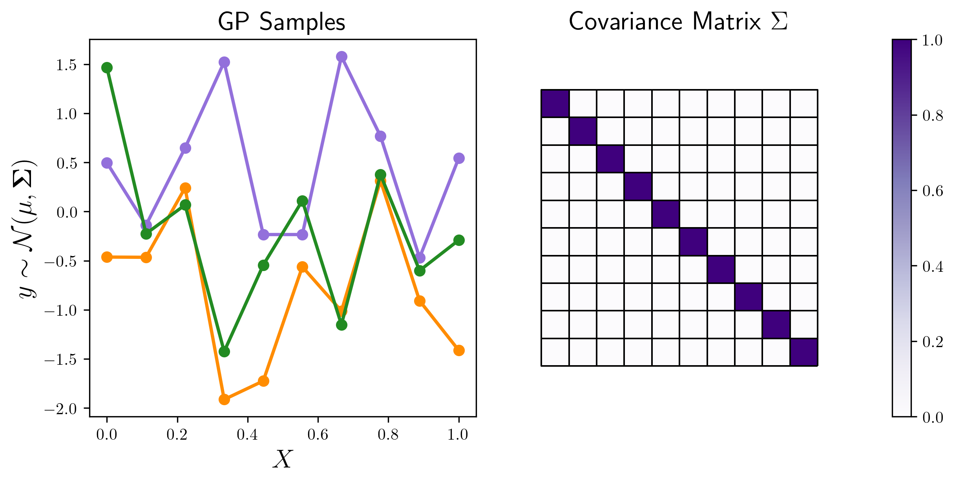
Gaussian Process
“A stochastic process where samples are generated by drawing from a multivariate Gaussian distribution indexed by time, space or some other domain.”
Three samples from the GP.
“… indexed by time, space or some other domain.”

Slide 17
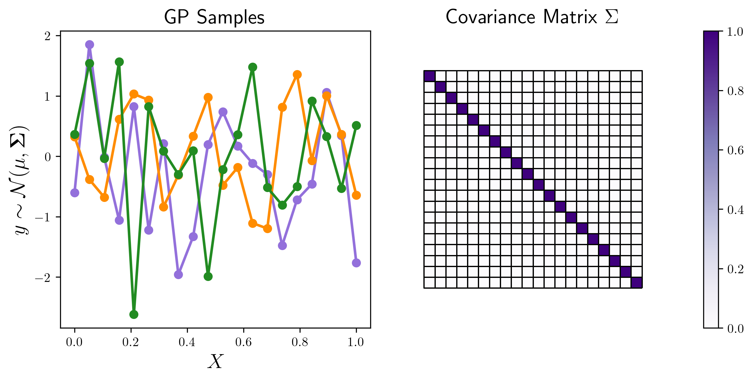
Gaussian Process
“A stochastic process where samples are generated by drawing from a multivariate Gaussian distribution indexed by time, space or some other domain.”
Three samples from the GP.
“… indexed by time, space or some other domain.”

Slide 18
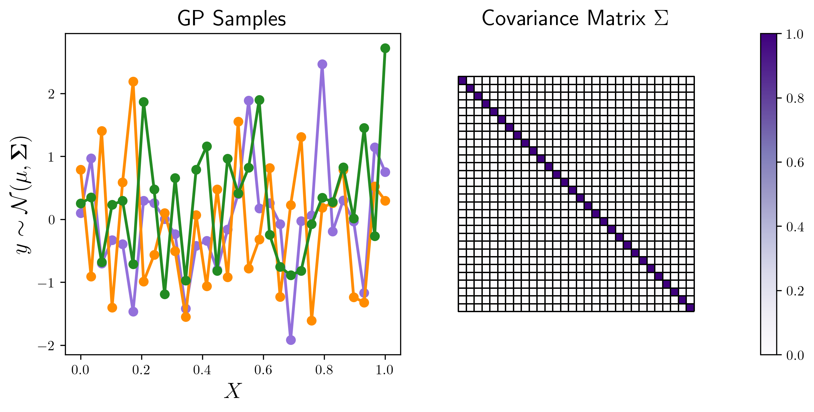
Gaussian Process
“A stochastic process where samples are generated by drawing from a multivariate Gaussian distribution indexed by time, space or some other domain.”

Slide 19
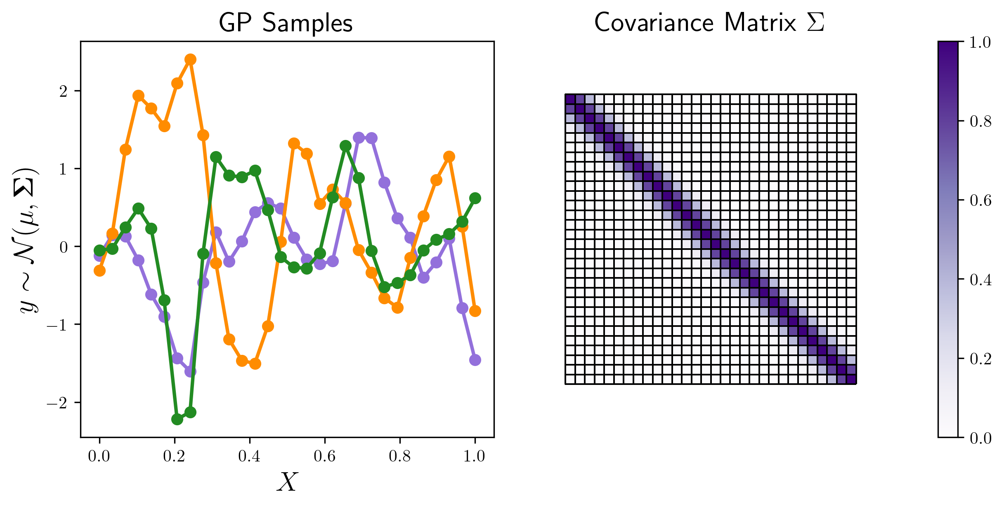
Gaussian Process
“A stochastic process where samples are generated by drawing from a multivariate Gaussian distribution indexed by time, space or some other domain.”
More structure in the covariance matrix

Slide 20
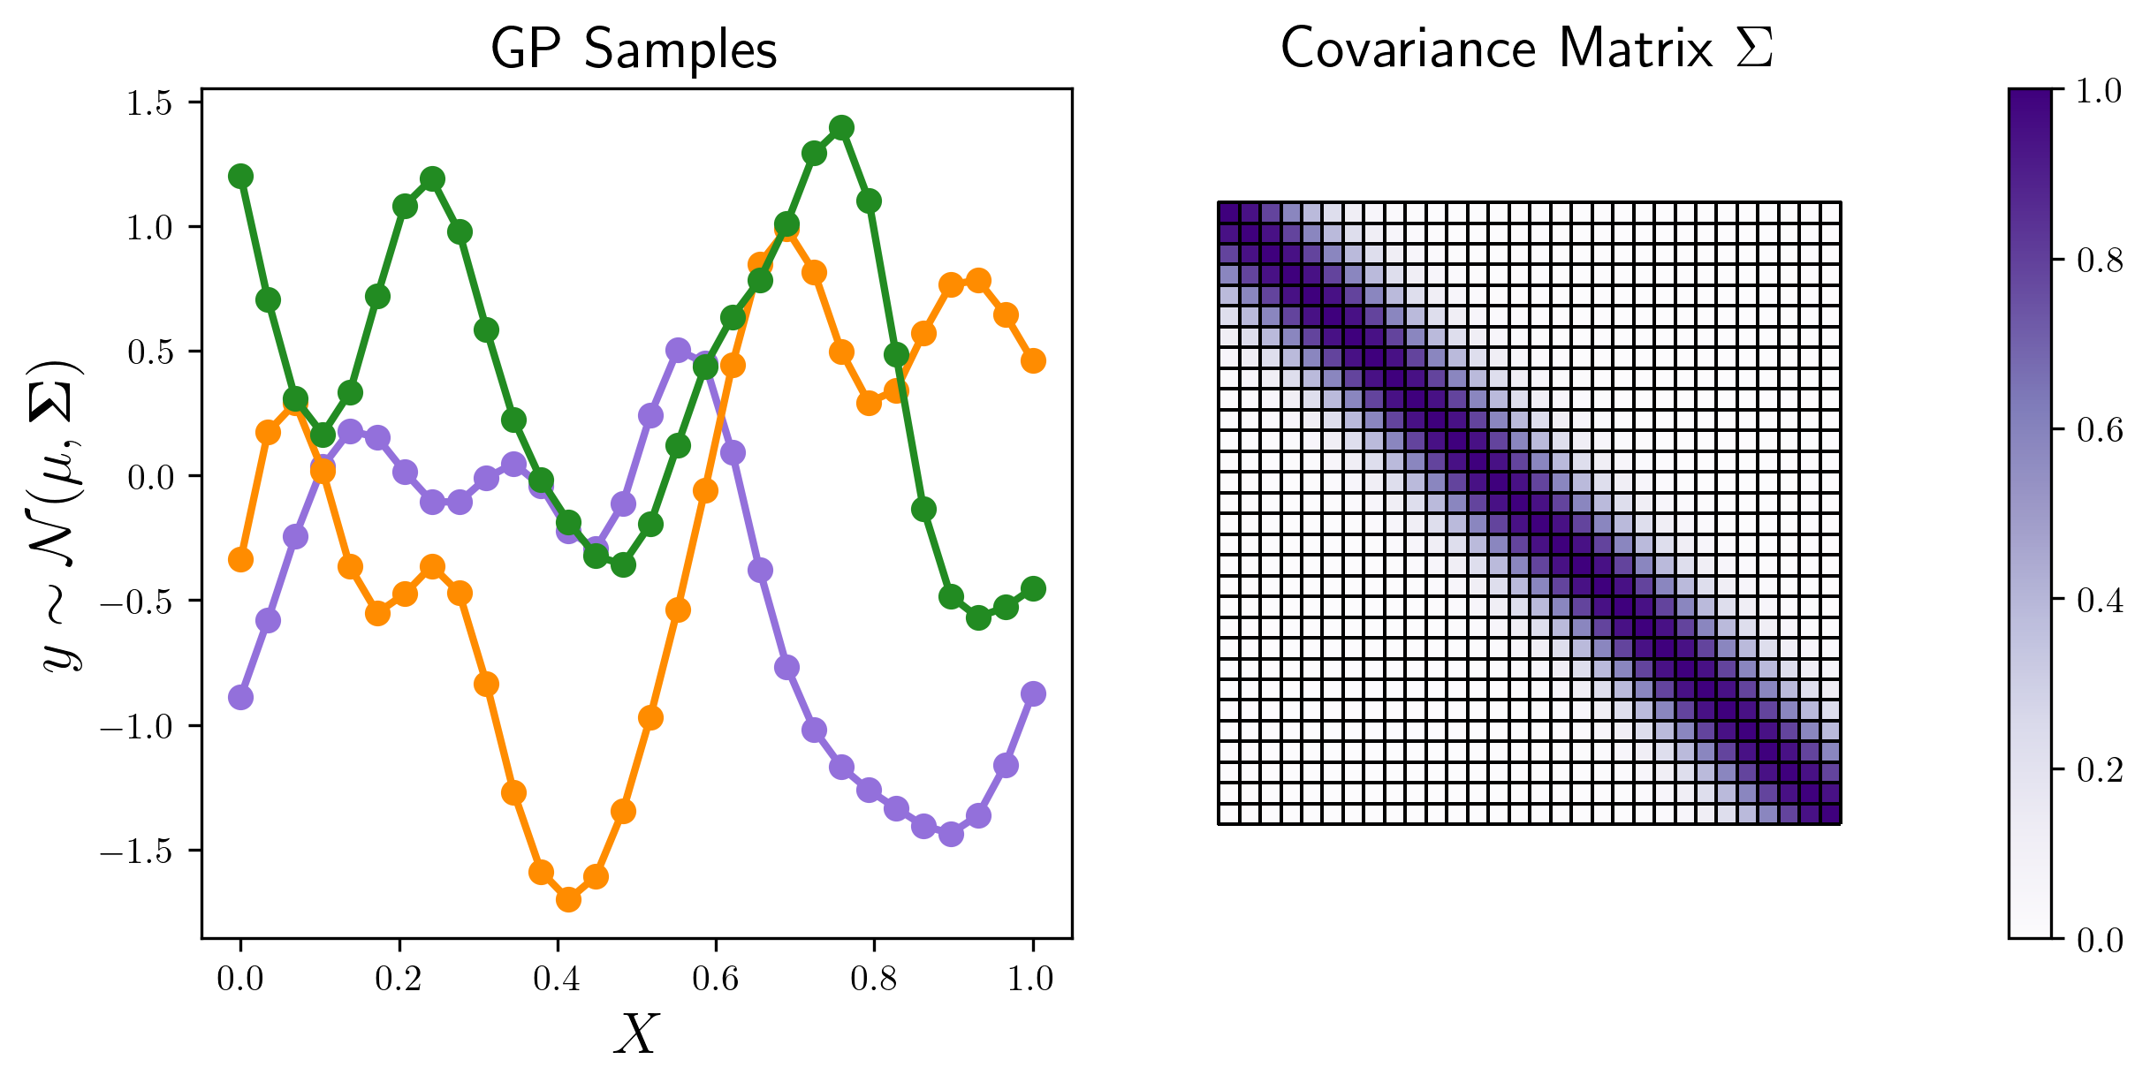
Gaussian Process
“A stochastic process where samples are generated by drawing from a multivariate Gaussian distribution indexed by time, space or some other domain.”
More structure in the covariance matrix

Slide 21
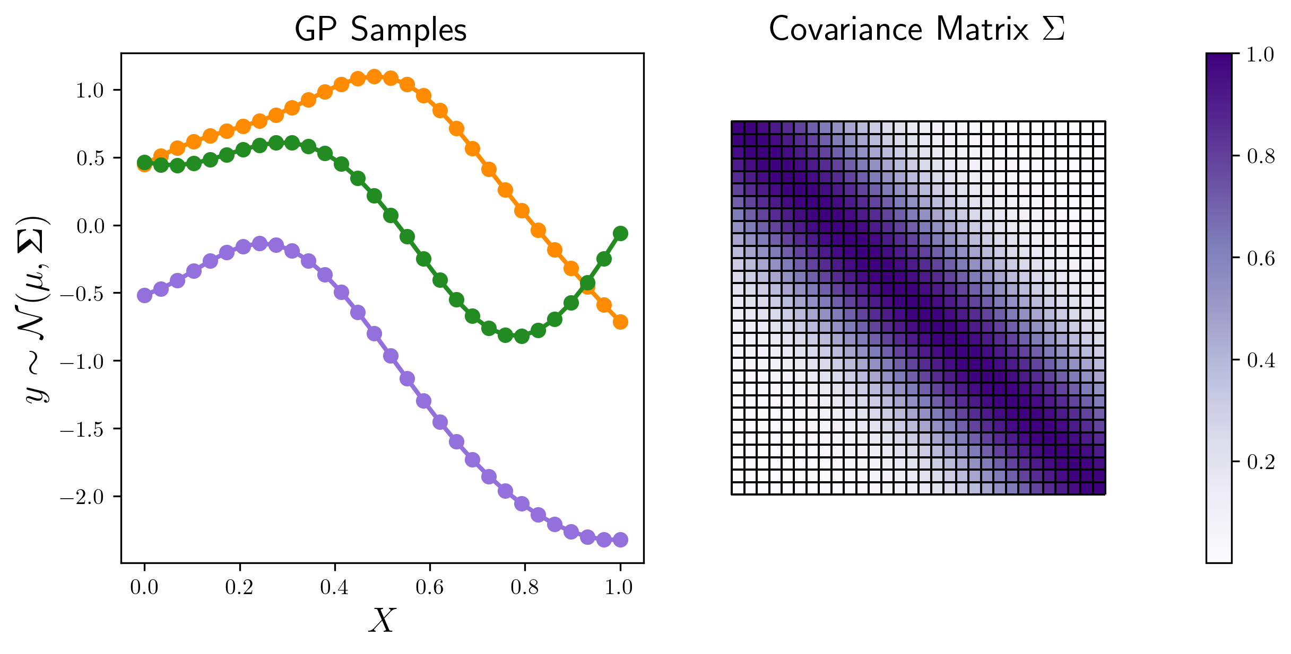
Gaussian Process
“A stochastic process where samples are generated by drawing from a multivariate Gaussian distribution indexed by time, space or some other domain.”
More structure in the covariance matrix

Slide 22
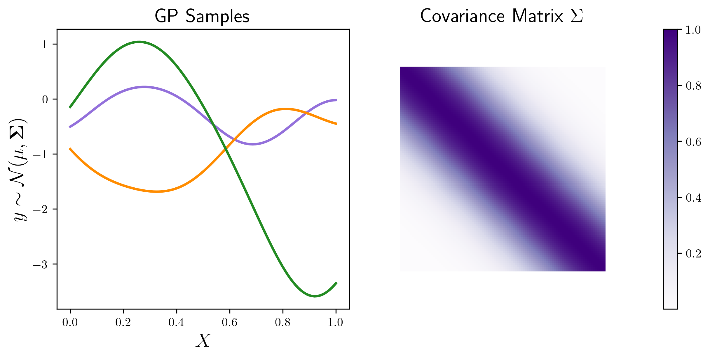
Gaussian Process
“A stochastic process where samples are generated by drawing from a multivariate Gaussian distribution indexed by time, space or some other domain.”
Covariance function
Gaussian Process
“A probability distribution over functions, where any finite collection of function values is jointly Gaussian distributed.”

Slide 23
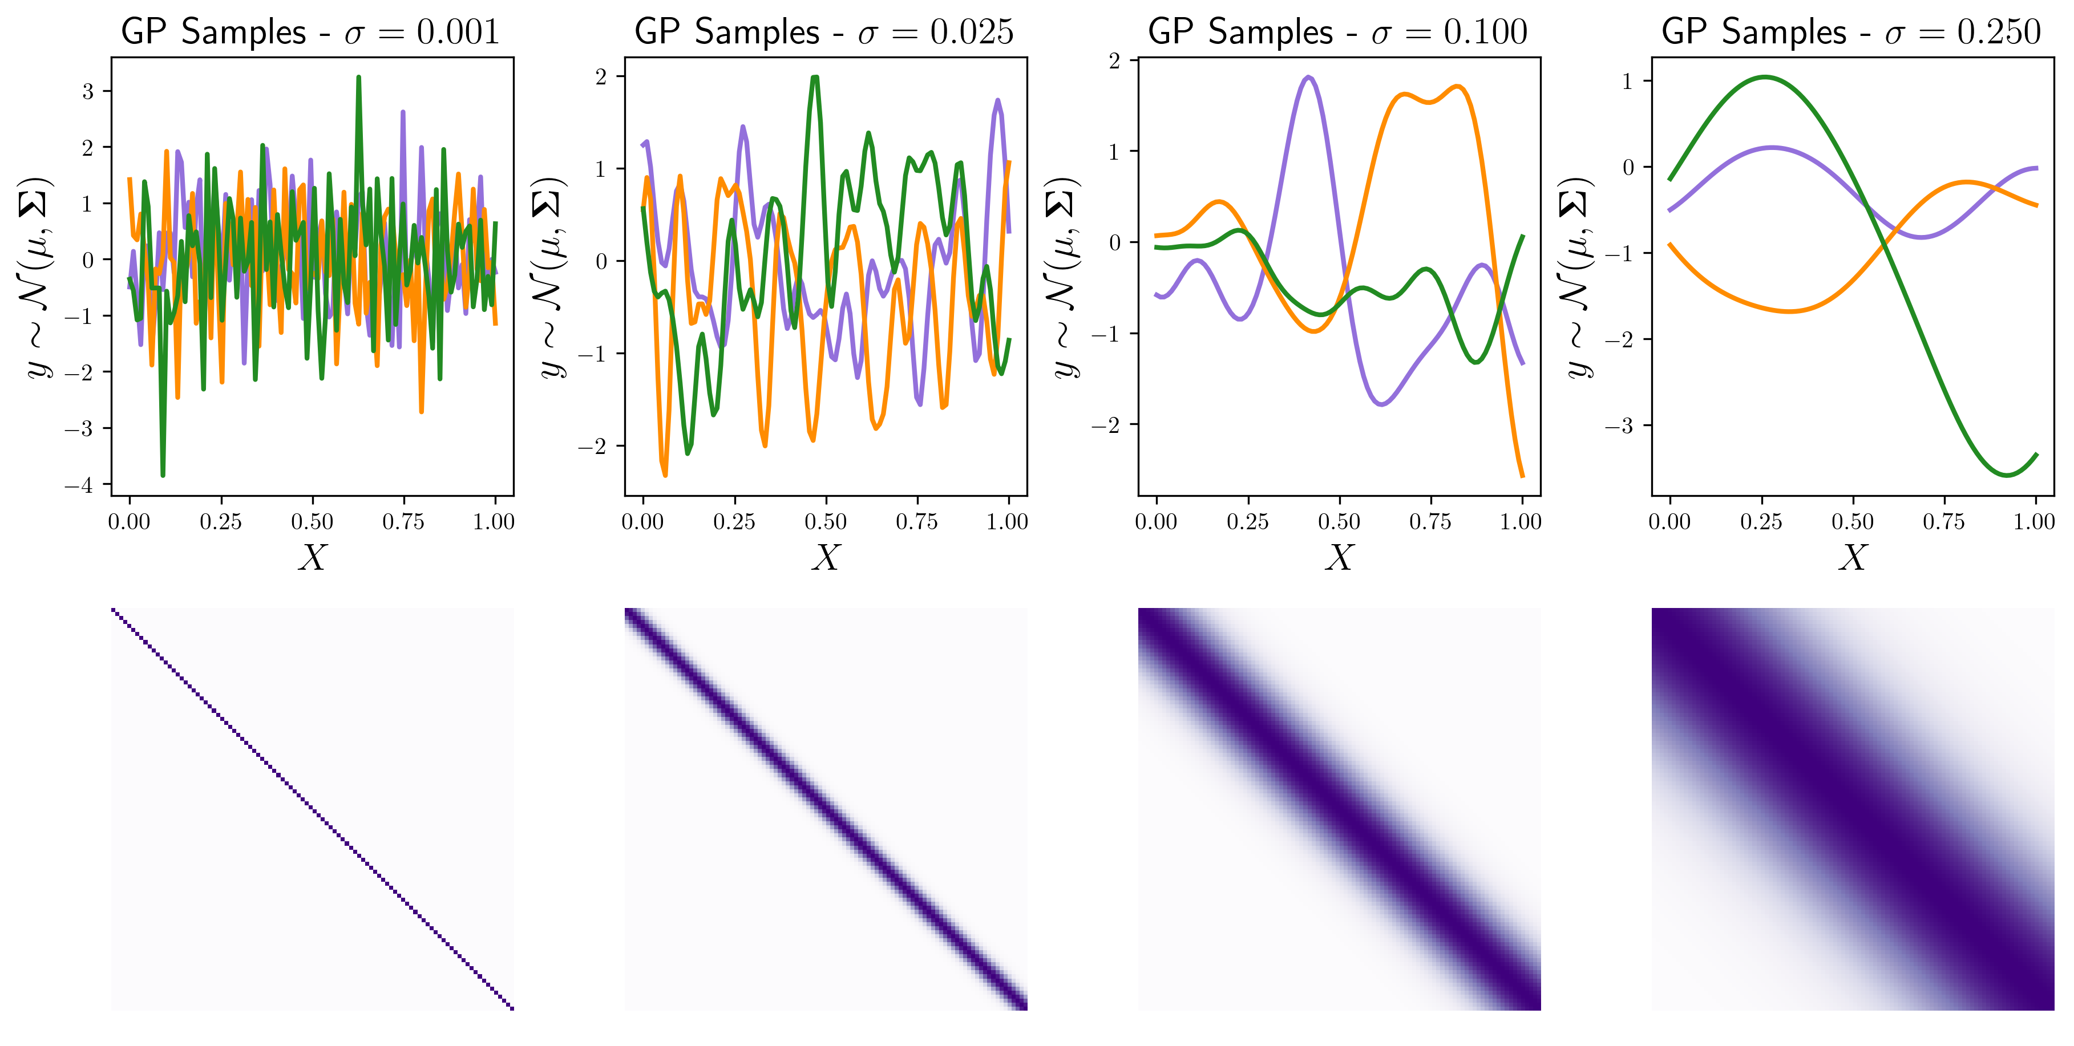
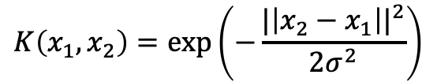
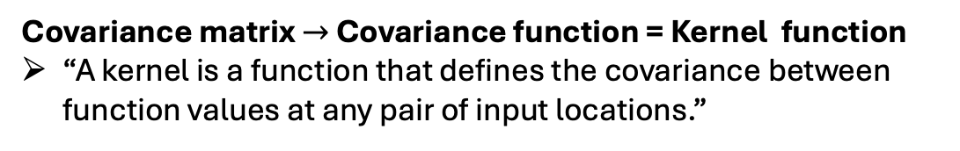
Covariance matrix $→$ Covariance function = Kernel function
“A kernel is a function that defines the covariance between function values at any pair of input locations.”
$$K\left(x_{1},x_{2}\right)=exp⁡\left(−\frac{{|\left|x_{2}−x_{1}\right||}^{2}}{{2σ}^{2}}\right)$$
RBF or Gaussian kernel.

Slide 24
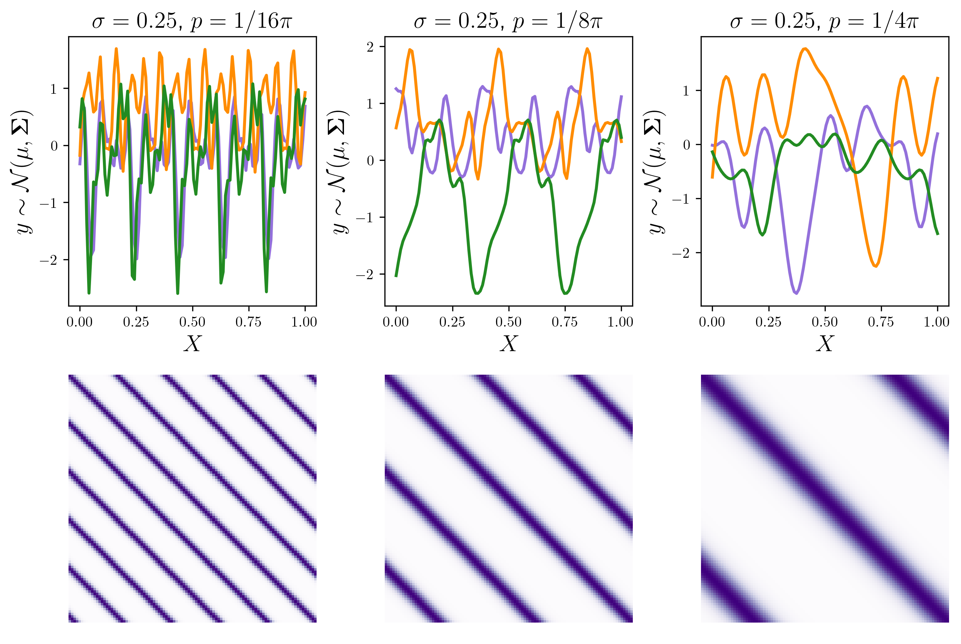
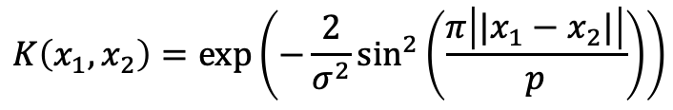
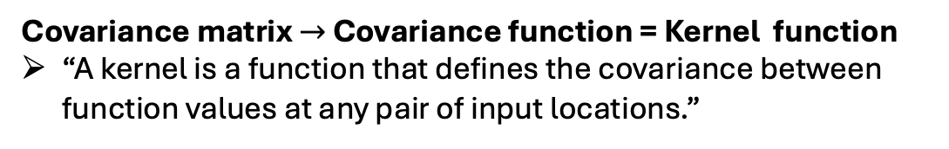
Covariance matrix $→$ Covariance function = Kernel function
“A kernel is a function that defines the covariance between function values at any pair of input locations.”
$$K\left(x_{1},x_{2}\right)=exp⁡\left(−\frac{2}{σ^{2}}\sin^{2}\left(\frac{π\left|{|x}_{1}−x_{2}|\right|}{p}\right)\right)$$
Periodic kernel

Slide 25
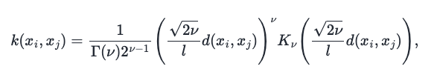

Covariance matrix $→$ Covariance function = Kernel function
“A kernel is a function that defines the covariance between function values at any pair of input locations.”
Matern kernel
Discontinuous
Twice differentiable
Once differentiable

Slide 26


Covariance matrix $→$ Covariance function = Kernel function
“A kernel is a function that defines the covariance between function values at any pair of input locations.”
$$K\left(x_{1},x_{2}\right)={{((x}_{1}−c)∗{(x}_{2}−c))}^{α}$$
Polynomial kernel

Slide 27

Gaussian Processes & Regressors
Multivariate Gaussian distribution
Multivariate normal distribution parameterized by the mean $μ$ and the covariance $Σ$.
Stochastic Process:
"A collection of random variables indexed by time, space, or some other domain.”
Gaussian Process
“A probability distribution over functions, where any finite collection of function values is jointly Gaussian distributed.”

Slide 28


How to use for regression?

Slide 29


Naïve Gaussian Process Regression:
Given targets $f\left(x_{target}\right)=y_{target}$
Sample a large number of functions from the GP
Keep only those functions that are sufficiently close to $y_{target}$ at $x_{target}$
Say that our fit is the mean of the qualified samples

Slide 30

Naïve Gaussian Process Regression:
Given targets $f\left(x_{target}\right)=y_{target}$
Sample a large number of functions from the GP
Keep only those functions that are sufficiently close to $y_{target}$ at $x_{target}$
Say that our fit is the mean of the qualified samples

Slide 31

Naïve Gaussian Process Regression:
Given targets $f\left(x_{target}\right)=y_{target}$
Sample a large number of functions from the GP
Keep only those functions that are sufficiently close to $y_{target}$ at $x_{target}$
Say that our fit is the mean of the qualified samples

Slide 32

Naïve Gaussian Process Regression:
Given targets $f\left(x_{target}\right)=y_{target}$
Sample a large number of functions from the GP
Keep only those functions that are sufficiently close to $y_{target}$ at $x_{target}$
Say that our fit is the mean of the qualified samples

Slide 33


Naïve Gaussian Process Regression:
Given targets $f\left(x_{target}\right)=y_{target}$
Sample a large number of functions from the GP
Keep only those functions that are sufficiently close to $y_{target}$ at $x_{target}$
Say that our fit is the mean of the qualified samples
Problem: The number of samples that fit falls by about a factor of 10 pr. Added data point.
$$10000→1769→144→13$$
Among other problems.
Can something smarter be done?

Slide 34

Bayes Theorem
Rule to compute a conditional distribution from a joint distribution.
$$p\left(y | X\right)=\frac{p\left(X | y\right)p\left(y\right)}{p(X)}$$

Slide 35


Bayes Theorem
Rule to compute a conditional distribution from a joint distribution.
Joint prior distribution
Due to the magical properties of Gaussians the mean and covariance of the conditional distribution are
$$μ^{∗}=K\left(X^{∗}, X\right)K{\left(X, X\right)}^{−1}f$$
$$Σ^{∗}=K\left(X^{∗}, X^{∗}\right)−K\left(X^{∗}, X\right)K{\left(X, X\right)}^{−1}K\left(X, X^{∗}\right)$$
In GP terminology these are typically called the posterior mean and covariance.

Slide 36




$$μ=0$$
$$μ^{∗}=K\left(X^{∗}, X\right)K{\left(X, X\right)}^{−1}f$$
$$Σ^{∗}=K\left(X^{∗}, X^{∗}\right)−K\left(X^{∗}, X\right)K{\left(X, X\right)}^{−1}K\left(X, X^{∗}\right)$$
$$Σ=K(X^{∗},X^{∗})$$

Slide 37












$$K\left(X^{∗}, X\right)$$
$$K{\left(X, X\right)}^{−1}$$
$$f$$
$$μ^{∗}=K\left(X^{∗}, X\right)K{\left(X, X\right)}^{−1}f$$
$$⋅$$
$$⋅$$
$$α$$
$$K\left(X^{∗}, X\right)$$
$$=K\left(X^{∗},X\right)α$$
$$⋅$$
$$=\sum_{i}{α_{i}K(X^{∗},X_{i})}$$
$$+$$
$$+$$

Slide 38




$$μ^{∗}=\sum_{i}{α_{i}K\left(X^{∗},X_{i}\right)=}$$
$$+$$
$$+$$
Weights $α_{i}$ come from the conditioning
Kernels placed at observations as basis functions

Slide 39


Bayes Theorem
Rule to compute a conditional distribution from a joint distribution.
Joint prior distribution with noisy observations
Due to the magical properties of Gaussians the mean and covariance of the conditional distribution are
$$μ^{∗}=K\left(X^{∗}, X\right){\left[K\left(X,X\right)+σ_{n}^{2}I\right]}^{−1}f$$
$$Σ^{∗}=K\left(X^{∗}, X^{∗}\right)−K\left(X^{∗}, X\right){\left[K\left(X,X\right)+σ_{n}^{2}I\right]}^{−1}K\left(X, X^{∗}\right)$$
In GP terminology these are typically called the posterior mean and covariance.

Slide 40




$$μ^{∗}=K\left(X^{∗}, X\right)[K{\left(X, X\right)}^{−1}+σ_{n}^{2}I]f$$
Rather than plotting samples we can just plot the 2 std confidence interval resulting from the covariance.
Posterior mean less obliged to hit the data $→$
Reverts to prior mean = 0
More noisy observations $→$ Less confident

Slide 41




Kernel ridge regression
$$μ^{∗}=K\left(X^{∗}, X\right)\left[K{\left(X, X\right)}^{−1}+σ_{n}^{2}I\right]f=\sum_{i}{α_{i}K(X^{∗},X_{i})}$$
$$L(α)={\left\|\sum_{i}{α_{i}K\left(X^{∗},X_{i}\right)}−y_{i}\right\|}^{2}+σ_{n}^{2}|\left|α\right||$$
$$←→$$
Rather than plotting samples we can just plot the 2 std confidence interval resulting from the covariance.
More noisy observations $→$ Less confident
Posterior mean less obliged to hit the data $→$
Reverts to prior mean = 0

Slide 42



Covariance matrix $→$ Covariance function = Kernel function
“A kernel is a function that defines the covariance between function values at any pair of input locations.”
$$K\left(x_{1},x_{2}\right)=exp⁡\left(−\frac{{|\left|x_{2}−x_{1}\right||}^{2}}{{2λ}^{2}}\right)$$
Longer length scale $λ$ gives a mean that changes slowly and the “relative distance” to observation is smaller so less variance $→$ Tighter confidence intervals.

Slide 43


Covariance matrix $→$ Covariance function = Kernel function
“A kernel is a function that defines the covariance between function values at any pair of input locations.”
$$K\left(x_{1},x_{2}\right)=exp⁡\left(−\frac{2}{σ^{2}}\sin^{2}\left(\frac{π\left|{|x}_{1}−x_{2}|\right|}{p}\right)\right)$$
Periodic kernel
The periodic kernel introdues low variance regions where we don’t have direct obsevations

Slide 44


$$K\left(x_{1},x_{2}\right)=\exp\left(−\frac{{\left|\left|x_{2}−x_{1}\right|\right|}^{2}}{{2λ}^{2}}\right)$$
Additional datapoint fits well
Additional datapoint fits poorly
Distribution does not contain functions that can fit all the points
The kernel function has poor parameters!

Slide 45



Log marginal likelihood
“Log-probability of observing the data under the GP model, integrating over all possible latent functions”
Likelihood
Prior
Again Gaussians have magical nice properties
$$\log{p\left(y | X\right)=−\frac{1}{2}y^{T}{\left(K_{θ}(X, X)+σ_{n}^{2}I\right)}^{−1}}y$$
Data fit
$$−\frac{1}{2}\log\left|K_{θ}(X, X)+σ^{2}I\right|$$
Model complexity
$$−\frac{n}{2}\log{2π}$$
Normalization

Slide 46






$$\log{p\left(y | X\right)=−\frac{1}{2}y^{T}{\left(K_{θ}(X, X)+σ_{n}^{2}I\right)}^{−1}}y−\frac{1}{2}\log\left|K_{θ}(X, X)+σ^{2}I\right|−\frac{n}{2}\log{2π}$$

Slide 47





$$\log{p\left(y | X\right)=−\frac{1}{2}y^{T}{\left(K_{θ}(X, X)+σ_{n}^{2}I\right)}^{−1}}y−\frac{1}{2}\log\left|K_{θ}(X, X)+σ^{2}I\right|−\frac{n}{2}\log{2π}$$

Slide 48



Slide 49
LML typically optimized using gradient-based approach
$$∇_{θ} log{p_{θ}\left(y | X\right)}$$
This is much easier with automatic differentiation.

Slide 50




Functions of multiple variables
All handled by the kernel – and all the kernels we’ve seen can do so.
$$X=\left[x_{1}, x_{2}, …, x_{n}\right]→X=\left[\left(x_{1},y_{1}\right), \left(x_{2},y_{2}\right), …\left(x_{N}, y_{N}\right)\right]=[x_{1},x_{2}, …x_{N}]$$
$$K\left(x_{1},x_{2}\right)=exp⁡\left(−\frac{{|\left|x_{2}−x_{1}\right||}^{2}}{{2σ}^{2}}\right)$$
Covariance
Posterior mean
Function sampled from prior

Slide 51
Gaussian Processes & Regressors For Materials Science / Astrochemistry

Slide 52


Covariance of atomic configurations.
$K($ , )

Slide 53

Structural descriptor
A representation of an atomic structure that encodes invariances.
Invariances
Translation
Rotation
Permutation
Cartesian coordinates are terrible at this.
$$x_{1}$$ | $$y_{1}$$ | $$z_{1}$$
$$x_{2}$$ | $$y_{2}$$ | $$z_{2}$$
… | … | …
$$x_{N}$$ | $$y_{N}$$ | $$z_{N}$$
Notes:
If you need to plot it to tell if two representations are the same, then they are terrible representations.

Slide 54


Fingerprint descriptor
A smooth histogram of bond lengths (and angles) representing an atomic configuration as a vector.

Slide 55


Bayesian Optimization
Acquisition function based on the GP decides where the target function should be queried.
$$f\left(X\right)=μ\left(x\right)−κσ(x)$$

Slide 56

Bayesian Optimization
The surrogate GP landscape is used to find promising configurations to calculate with DFT.
Phys. Rev. Lett. 124, 086102

Slide 57
Bayesian Optimization
The surrogate GP landscape is used to find promising configurations to calculate with DFT.
Phys. Rev. Lett. 124, 086102

Slide 58
Bayesian Optimization
The surrogate GP landscape is used to find promising configurations to calculate with DFT.
Phys. Rev. Lett. 124, 086102

Slide 59





Carbon clusters on Ir(111)
Nitrogen-Ruthenium defects in graphene
J. Chem. Phys. 157, 054701 (2022)
Phys. Rev. B 105, 245404
Tin-oxide on ${Pt}_{3}Sn(111)$
Sulfur-induced Cu(111) reconstruction
Angew. Chem. Int. Ed. 2022, 61, e202204244
J. Chem. Phys. 160, 174107 (2024)

Slide 60









Moment of inertia
$$I=\sum_{i}{m_{i}r_{i}^{2}}$$
How to calculate the covariance between these $K(𝒪_{1},𝒪_{2})$?
$$𝒪_{2}$$
$$𝒪_{1}$$
$$(m_{3}, r_{3})$$
$$(m_{2}, r_{2})$$
$$(m_{2}, r_{2})$$
$$(m_{1}, r_{1})$$
$$(m_{1}, r_{1})$$
Center of rotation.

Slide 61












$$𝒪_{1}$$
$$X_{1}=$$
$$X_{2}=$$
$$(m_{2}, r_{2})$$
$$(m_{1}, r_{1})$$
$$K\left(X_{1},X_{2}\right)=$$
$$𝒪_{2}$$
$$(m_{3}, r_{3})$$
1
$$(m_{2}, r_{2})$$
$$K\left(𝒪_{1},𝒪_{2}\right)=$$
1
1
1
1
$$=$$
$$(m_{1}, r_{1})$$
$$K\left(𝒪_{1},𝒪_{2}\right)=L_{1}K\left(X_{1},X_{2}\right)L_{2}^{T}$$

Slide 62

Training examples

Slide 63


One vector
$N_{atoms}$ vectors

Slide 64
Smooth Overlap of Atomic Positions (SOAP)
Power spectrum of the smoothend atomic density around an atom yields an invariant descriptor.
Phys. Rev. B 87, 184115, on SOAP
Figure from “Leveraging machine learning for materials discovery: Inverse catalysts for CO₂ hydrogenation”, Luuk Kempen

Slide 65


Sparse Gaussian Processes
For large (>1-5k) datasets regular GPR becomes prohibitively expensive,$𝒪(n^{3})$ training time and$𝒪(n)$ inference time. Sparse GPRs can be constructed with $𝒪(m^{2}n)$ training and$𝒪\left(m\right)$ inference where $m≪n.$
J. Chem. Phys. 157, 174115 (2022)

Slide 66





General purpose potential for Si
General purpose potential for phosphorus
Phys. Rev. X 8, 041048
Iron nanoparticles
Nat Commun 11, 5461 (2020)
Surface structure determination of Ir$O_{2}.$
J. Chem. Phys. 155, 244107 (2021)
Phys. Rev. B 107, 245421

Slide 67

Phase transition predictions
Optimized kernel allows GP model to predict two phase transitions while only having seen data from one phase.
Phase transition I
Both solid lines are from reference calculations
Phase transition II
Observations
PRL 121, 255702 (2018)

Slide 68

Gaussian Processes for Machine Learning
The bible of GPs for ML. PDF freely available from https://gaussianprocess.org/gpml/

Slide 69



Packages / Libraries:
Scikit-learn
Numpy implementation of GP regression.
GPyTorch
Torch.
GPJax
Jax.
GPFlow
Tensorflow.
Among many others…
Recommendation
Start with your own code, read the scikit learn implementation if something is tricky (Or from my tutorial on Friday).
If you need something more feature rich or efficient try GPJax or GPyTorch depending on which backend your more comfortable with.

Slide 70
Recap: Distributions over functions
Gaussian Processes are distributions over functions. Uniquely defined by a mean and a covariance function
Covariance function

Slide 71
Recap: Conditioning
Conditioning tightens the distribution such that only relevant functions are kept.

Slide 72

Recap: Kernels choice & hyperparameters
Kernel choice and hyperparameters control the form of the function in the GP distribution.

Slide 73
Recap: Log marginal likelihood
. The probability of observing the data with the current model.

Slide 74

Final remarks
GP’s are versatile models
Domain knowledge can be expressed through kernel choice.
Very data-efficient leading to good models even with little data.
Ideal for benchmarking: Building a sophisticated model? Compare to a GP!
Want to dive deeper?
Conditioning with gradient observations.
Sparse GP’s
Deep kernel learning
Student-T processes
And more…
$K($ , )
Slides here: nanospace2025.mads-peter.com

Slide 75
Acknowledgements
• This work is based upon work from COST Action CA21126 - Carbon molecular nanostructures in space (NanoSpace), supported by COST (European Cooperation in Science & Technology).
• COST (European Cooperation in Science &
Technology) is a funding agency for research and innovation networks. Our Actions help connect research initiatives across Europe and enable scientists to grow their ideas by sharing them with their peers. This boosts their research, career and innovation.
• www.cost.eu
• https://www.cost.eu/actions/CA21126/
• https://research.iac.es/proyecto/nanospace/

